Slide 1
Logistic Regression and Classification

Slide 2
Overview

Slide 3
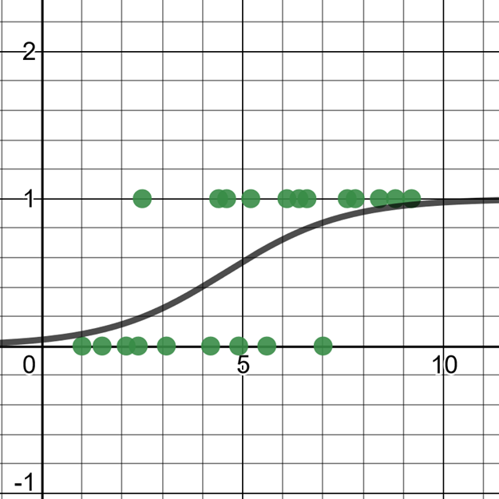
Agenda
Here is what we will do for the next 2 hours:
1
Logistic Regression Fundamentals
2
DISCUSSION: Space Shuttle Challenger
3
Preparing and Rescaling Data
4
ML Classification Validation

Slide 4
Section I Logistic Regression Fundamentals

Slide 5
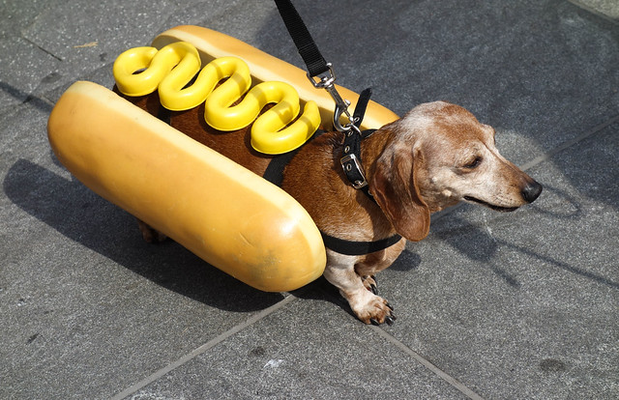
Classifying Things
So far we just did regressions via linear regression.
However, linear regressions are awkward to use for classification.
Lines extend in a straight direction for positive infinity and negative infinity, well outside a range of acceptable values.
Lines do not do a good job representing a probability and staying within the limits of 0.0 and 1.0.
When doing classification, probability is a critical tool.
Hot dog: 0.92

Slide 6
Classifying Things
Classification tasks are pretty common in machine learning:
How do I classify images of dogs versus cats?
Will a shipment be most likely be late, early, or on-time?
Is this email spam or not spam?
Will this movie get 1 star, 2 stars... or 5 stars?
There are several machine learning algorithms that work well for classification, and we are going to learn first about Logistic Regression.
Hot dog: 0.92

Slide 7
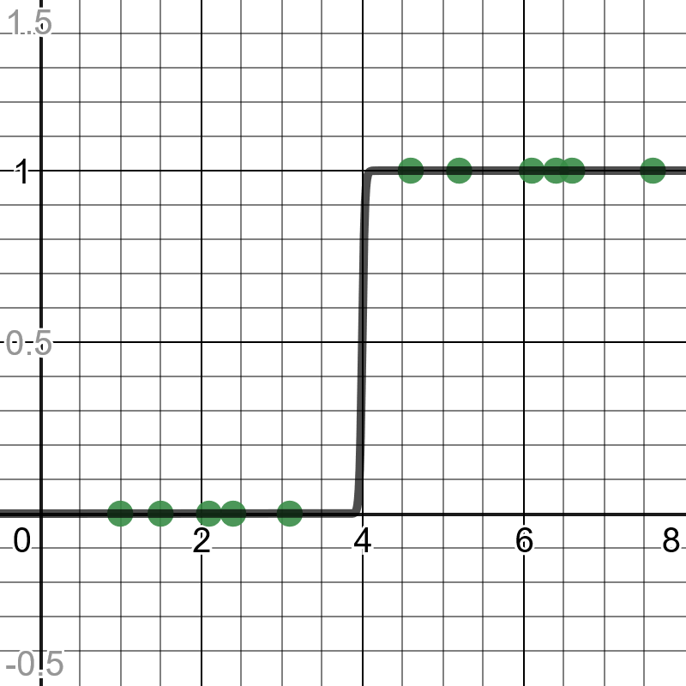
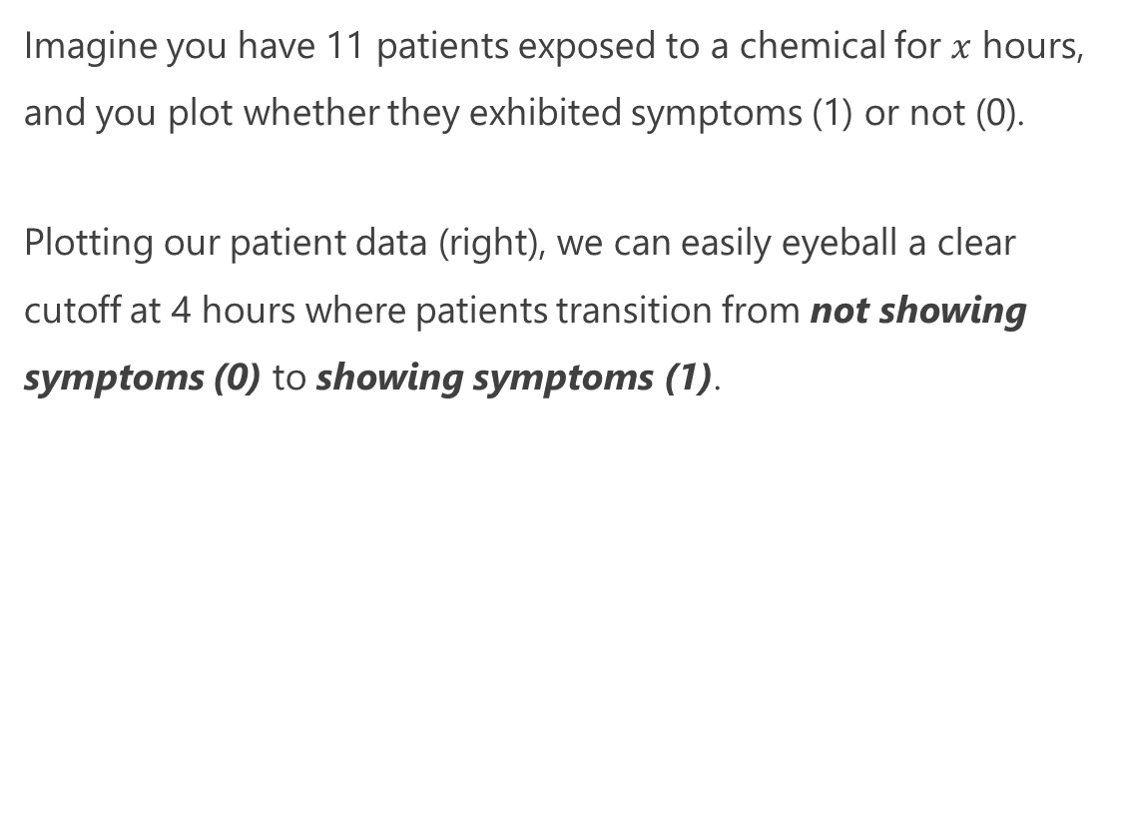
Logistic Regression Intuition
Imagine you have 11 patients exposed to a chemical for $x$ hours, and you plot whether they exhibited symptoms (1) or not (0).
Plotting our patient data (right), we can easily eyeball a clear cutoff at 4 hours where patients transition from not showing symptoms (0) to showing symptoms (1).
https://www.desmos.com/calculator/prs2p0sofc

Slide 8
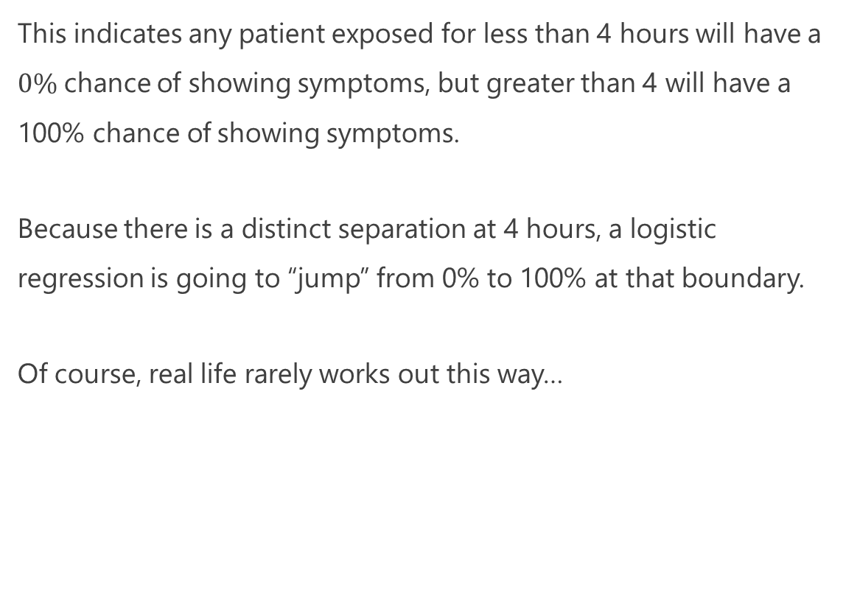
Logistic Regression Intuition
This indicates any patient exposed for less than 4 hours will have a $0\%$chance of showing symptoms, but greater than 4 will have a 100% chance of showing symptoms.
Because there is a distinct separation at 4 hours, a logistic regression is going to “jump” from 0% to 100% at that boundary.
Of course, real life rarely works out this way…
https://www.desmos.com/calculator/prs2p0sofc

Slide 9
Logistic Regression Intuition
Now let’s say you gathered more data and got a realistic picture, where the middle of the range has a mix of patients showing symptoms and not showing symptoms.
The way to interpret this is the probability of patients showing symptoms gradually increases with each hour of exposure.
Because of this overlap of points in the middle, there is no distinct cutoff when patients show symptoms, but rather a gradual transition from 0% probability to 100% probability (“0” and “1”).
https://www.desmos.com/calculator/bsqtqfians

Slide 10
Logistic Regression Intuition
More technically, a logistic regression results in a curve indicating a probability of belonging to the true (1) category, which in this case means a patient showed symptoms.
As the hours of chemical exposure increases, the number of patients showing symptoms increases, and thus the probability of showing symptoms increases.
https://www.desmos.com/calculator/bsqtqfians

Slide 11
Logistic Regression
Logistic Regression is a classification tool that predicts a true or false value for one or more variables.
Training data must have outcomes of 0 (false) or 1 (true), but the regression will output a probability value between 0 and 1.
An S-shaped curve (a logistic function) is fit to the points and then used to predict probability.
If a predicted value (the y-axis) is less than .5 it is typically categorized as false (0), and if the predicted value is greater than/equal to .5 it is typically categorized as true (1).
https://www.desmos.com/calculator/bsqtqfians

Slide 12
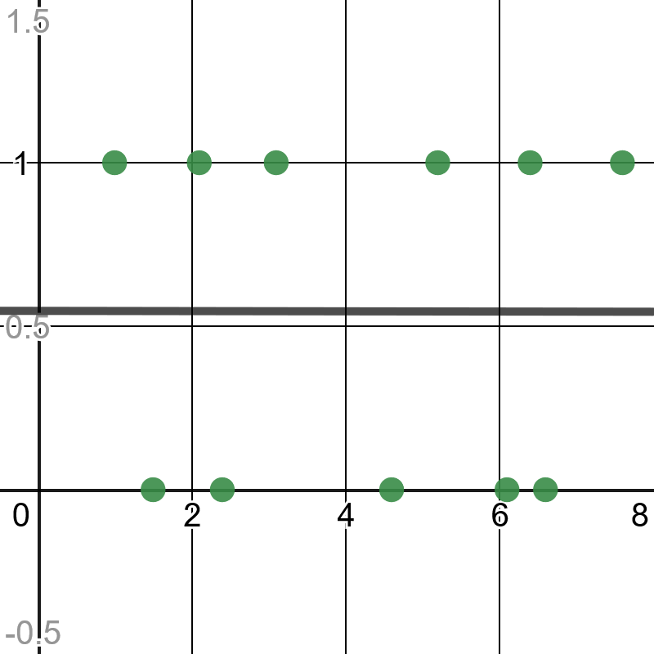
When Not To Use Logistic Regression
Of course, if there is no transitional trend in your data then you should not use logistic regression.
https://www.desmos.com/calculator/cmeksxk5rk

Slide 13
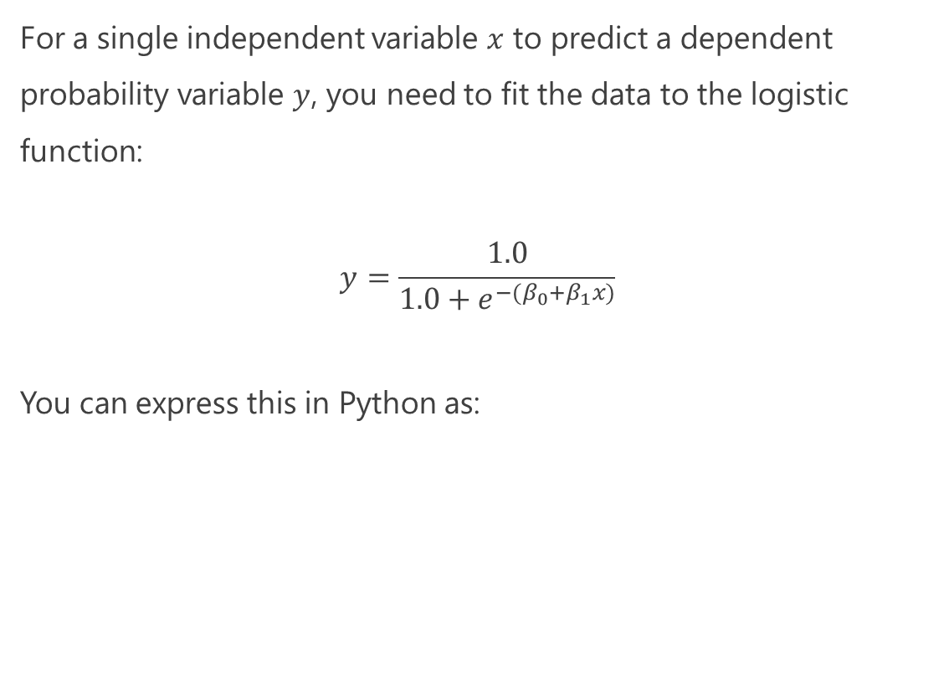
Just Show Me the Math!
For a single independent variable $x$ to predict a dependent probability variable $y$, you need to fit the data to the logistic function:
$$y=\frac{1.0}{1.0+e^{−{(β}_{0}+β_{1}x)}}$$
You can express this in Python as:
def predict_probability(x): p = 1.0 / (1.0 + math.exp(-(b0 + b1 * x))) return p
https://www.desmos.com/calculator/blfcwrlnuw

Slide 14
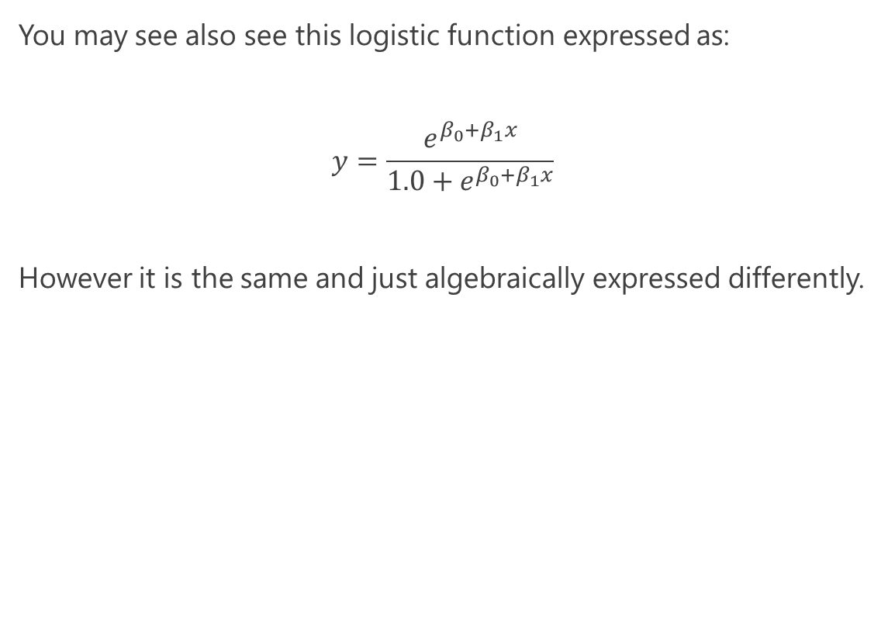
Just Show Me the Math!
You may see also see this logistic function expressed as:
$$y=\frac{e^{β_{0}+β_{1}x}}{1.0+e^{β_{0}+β_{1}x}}$$
However it is the same and just algebraically expressed differently.
https://www.desmos.com/calculator/blfcwrlnuw

Slide 15
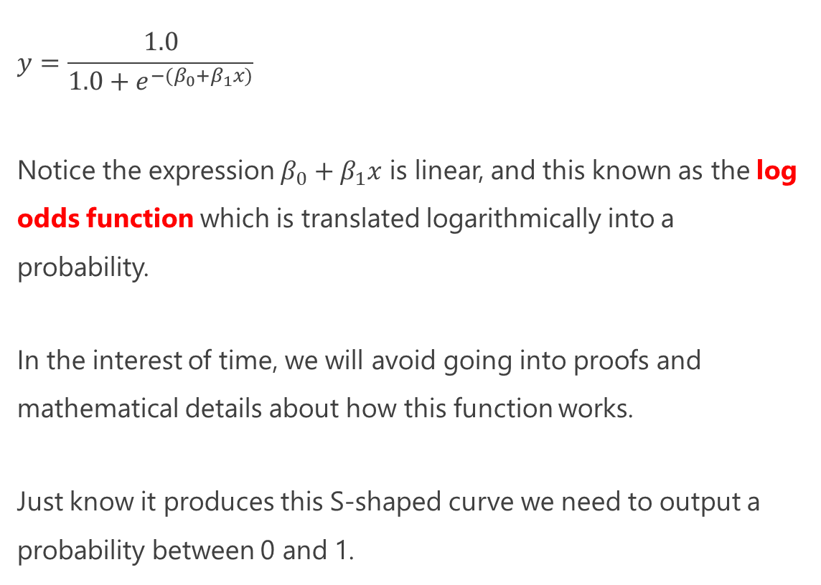
Just Show Me the Math!
$$y=\frac{1.0}{1.0+e^{−{(β}_{0}+β_{1}x)}}$$
Notice the expression $β_{0}+β_{1}x$ is linear, and this known as the log odds function which is translated logarithmically into a probability.
In the interest of time, we will avoid going into proofs and mathematical details about how this function works.
Just know it produces this S-shaped curve we need to output a probability between 0 and 1.
def predict_probability(x): p = 1.0 / (1.0 + math.exp(-(b0 + b1 * x))) return p
https://www.desmos.com/calculator/blfcwrlnuw

Slide 16
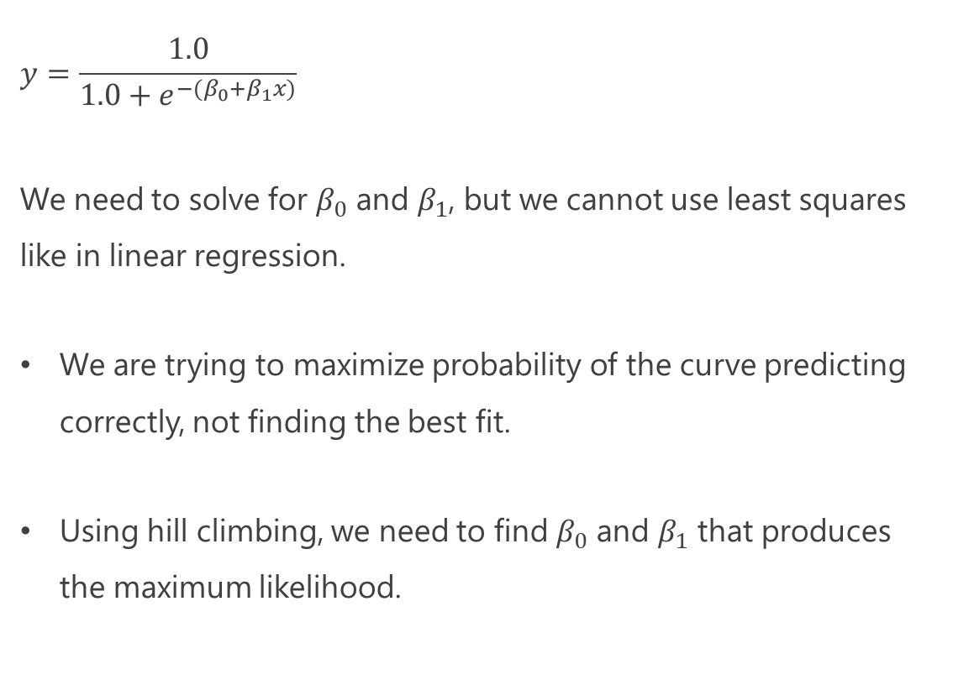
Just Show Me the Math!
$$y=\frac{1.0}{1.0+e^{−{(β}_{0}+β_{1}x)}}$$
We need to solve for $β_{0}$ and $β_{1}$, but we cannot use least squares like in linear regression.
We are trying to maximize probability of the curve predicting correctly, not finding the best fit.
Using hill climbing, we need to find $β_{0}$ and $β_{1}$ that produces the maximum likelihood.
def predict_probability(x): p = 1.0 / (1.0 + math.exp(-(b0 + b1 * x))) return p
https://www.desmos.com/calculator/blfcwrlnuw

Slide 17
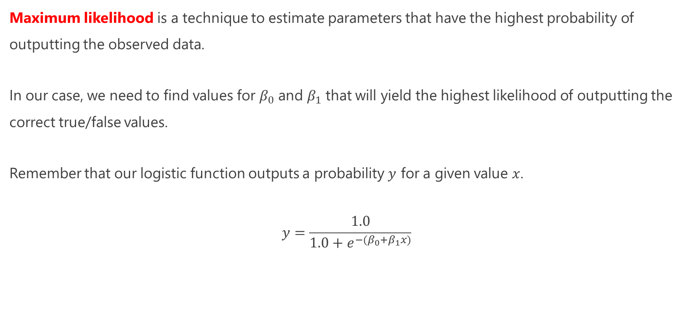
Maximum Likelihood
Maximum likelihood is a technique to estimate parameters that have the highest probability of outputting the observed data.
In our case, we need to find values for $β_{0}$ and $β_{1}$ that will yield the highest likelihood of outputting the correct true/false values.
Remember that our logistic function outputs a probability $y$ for a given value $x$.
$$y=\frac{1.0}{1.0+e^{−{(β}_{0}+β_{1}x)}}$$

Slide 18
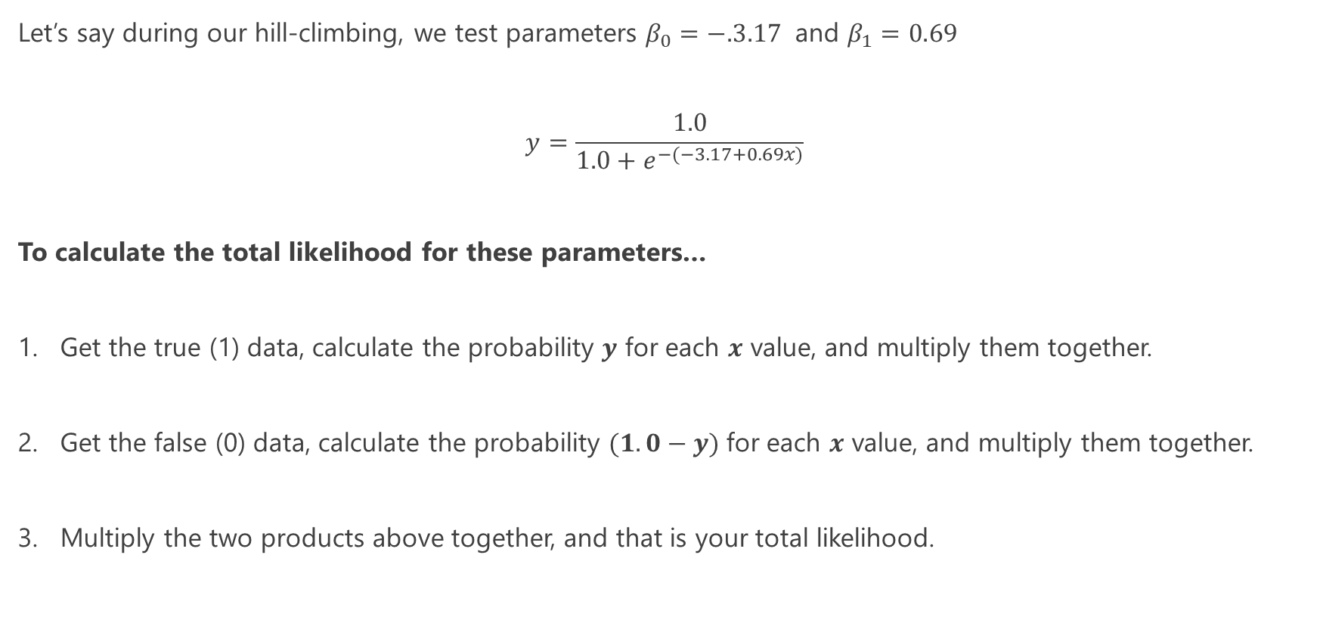
Maximum Likelihood
Let’s say during our hill-climbing, we test parameters $β_{0}=−.3.17$ and $β_{1}=0.69$
$$y=\frac{1.0}{1.0+e^{−(−3.17+0.69x)}}$$
To calculate the total likelihood for these parameters…
Get the true (1) data, calculate the probability $y$ for each $x$ value, and multiply them together.
Get the false (0) data, calculate the probability $(1.0−y)$for each $x$ value, and multiply them together.
Multiply the two products above together, and that is your total likelihood.

Slide 19
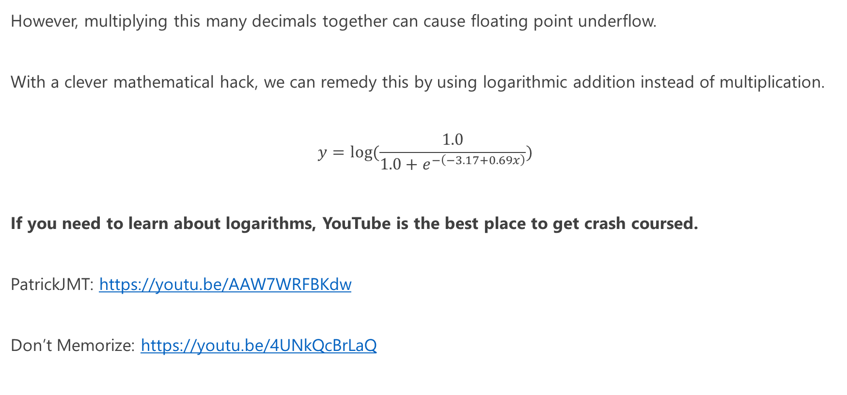
Maximum Likelihood – Avoiding Floating Point Underflow
However, multiplying this many decimals together can cause floating point underflow.
With a clever mathematical hack, we can remedy this by using logarithmic addition instead of multiplication.
$$y=log⁡(\frac{1.0}{1.0+e^{−\left(−3.17+0.69x\right)}})$$
If you need to learn about logarithms, YouTube is the best place to get crash coursed.
PatrickJMT: https://youtu.be/AAW7WRFBKdw
Don’t Memorize: https://youtu.be/4UNkQcBrLaQ

Slide 20
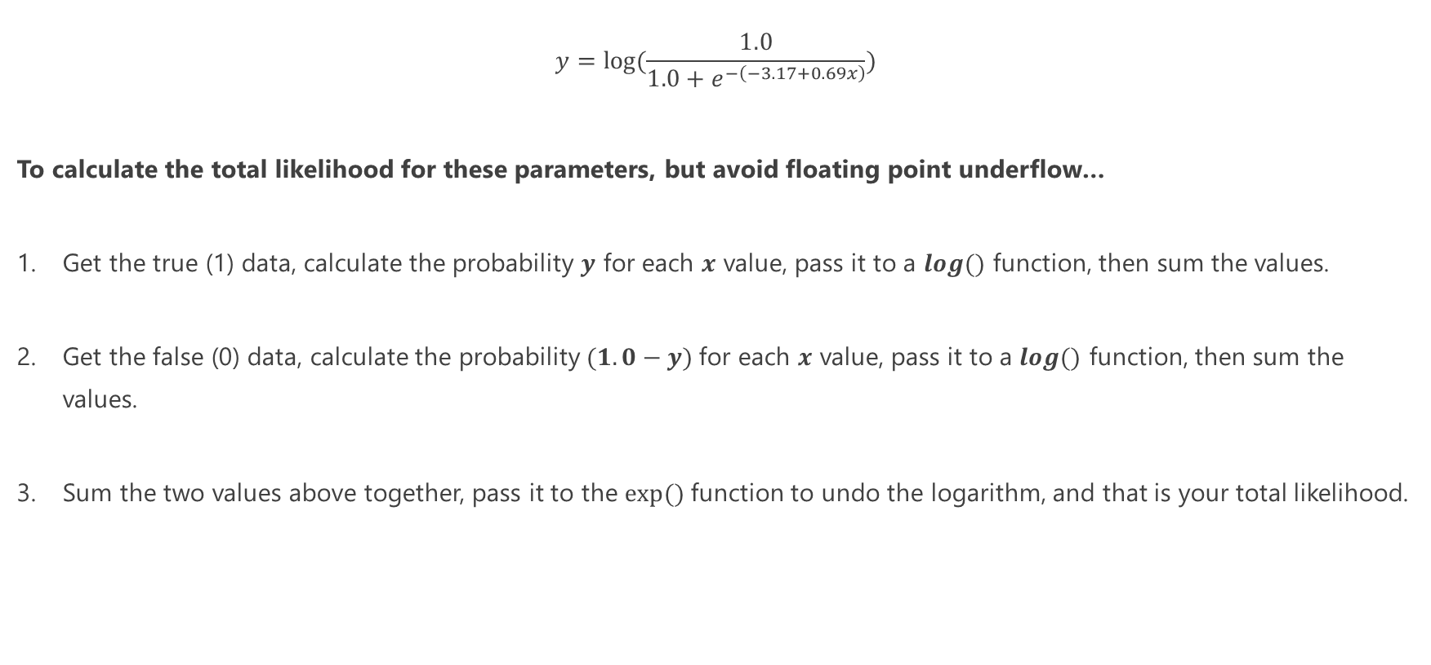
Maximum Likelihood – Avoiding Floating Point Underflow
$$y=log⁡(\frac{1.0}{1.0+e^{−\left(−3.17+0.69x\right)}})$$
To calculate the total likelihood for these parameters, but avoid floating point underflow…
Get the true (1) data, calculate the probability $y$ for each $x$ value, pass it to a $log⁡()$ function, then sum the values.
Get the false (0) data, calculate the probability $(1.0−y)$for each $x$ value, pass it to a $log⁡()$ function, then sum the values.
Sum the two values above together, pass it to the $exp⁡()$function to undo the logarithm, and that is your total likelihood.

Slide 21
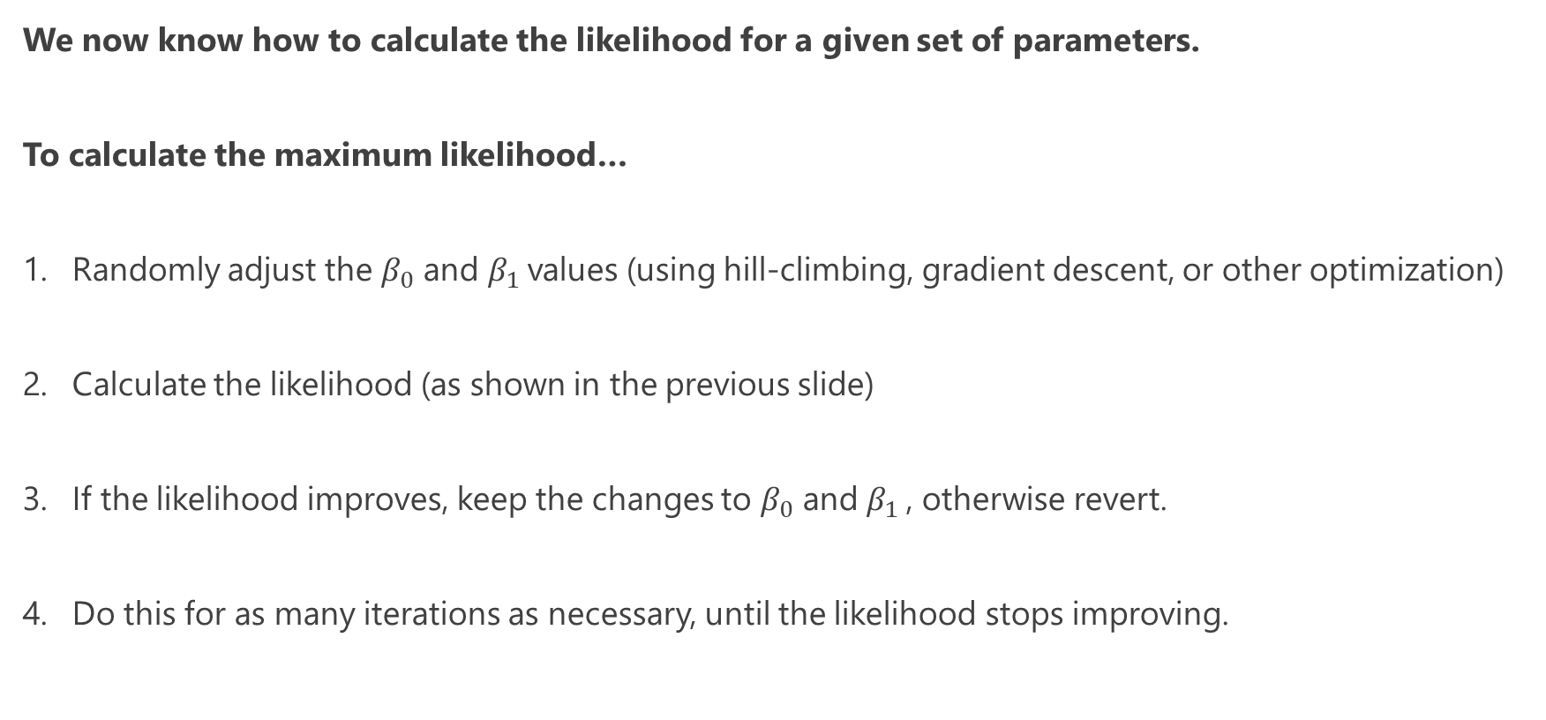
Maximum Likelihood
We now know how to calculate the likelihood for a given set of parameters.
To calculate the maximum likelihood…
Randomly adjust the $β_{0}$ and $β_{1}$values (using hill-climbing, gradient descent, or other optimization)
Calculate the likelihood (as shown in the previous slide)
If the likelihood improves, keep the changes to $β_{0}$ and $β_{1}$, otherwise revert.
Do this for as many iterations as necessary, until the likelihood stops improving.

Slide 22
Logistic Regression from Scratch
https://github.com/thomasnield/oreilly_math_fundamentals_data_science/blob/main/logistic_regression/1_logistic_regression_from_scratch.py

Slide 23
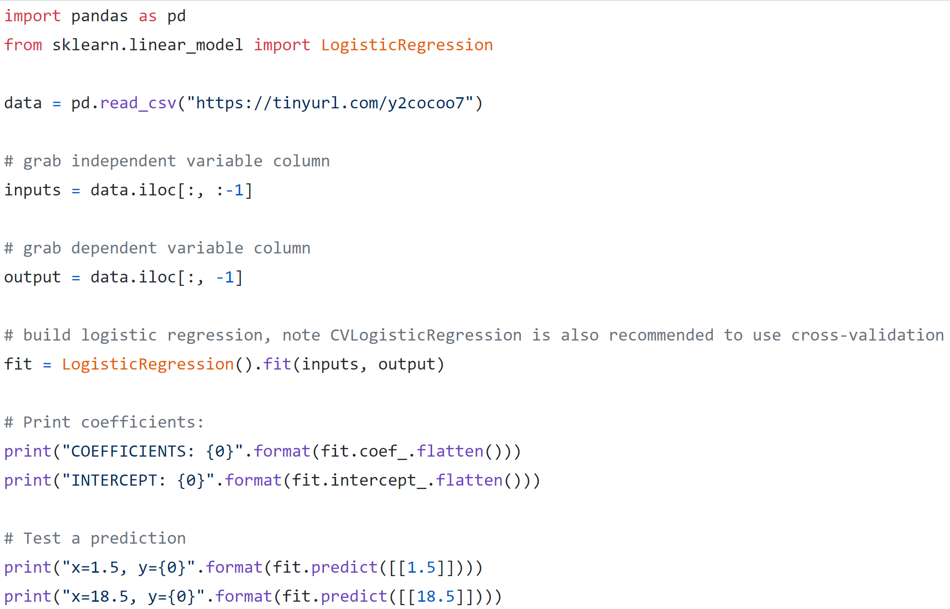
Hands-On: Logistic Regression with Scikit-Learn

Slide 24
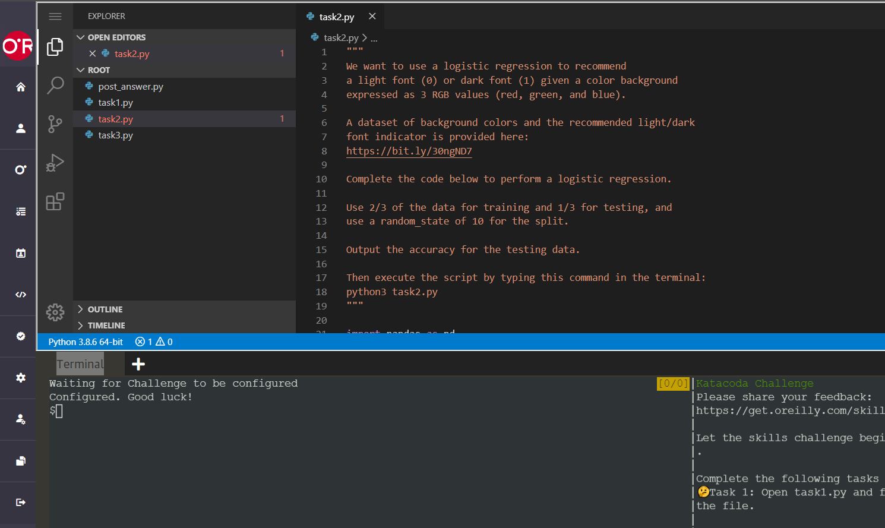
Katacoda – Task 1
https://learning.oreilly.com/scenarios/data-science-math/9781098108601/

Slide 25
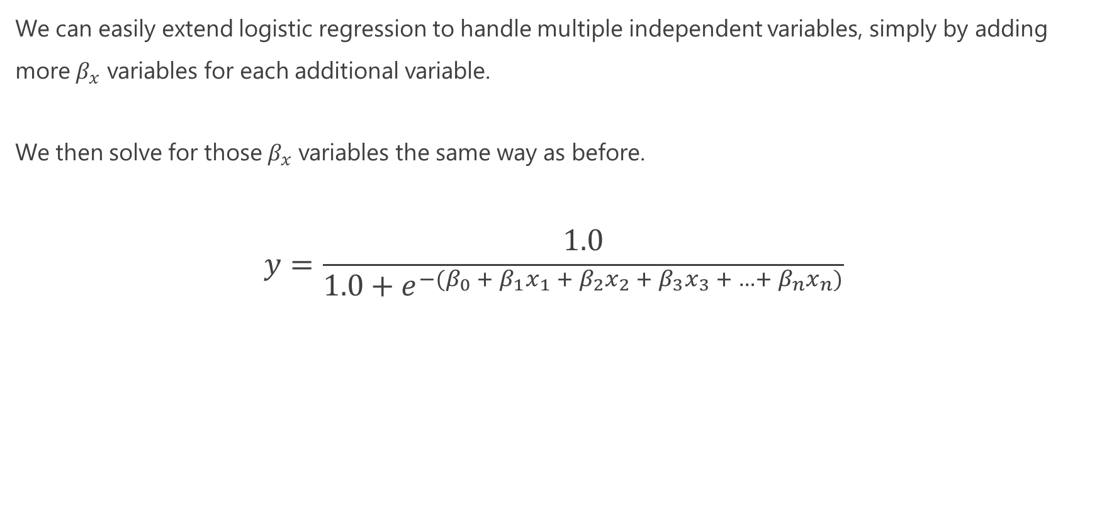
Multivariable Logistic Regression
We can easily extend logistic regression to handle multiple independent variables, simply by adding more $β_{x}$ variables for each additional variable.
We then solve for those $β_{x}$ variables the same way as before.
$$y=\frac{1.0}{1.0+e^{−{(β}_{0} + β_{1}x_{1} +{ β}_{2}x_{2} +{ β}_{3}x_{3} + …+{ β}_{n}x_{n})}}$$

Slide 26
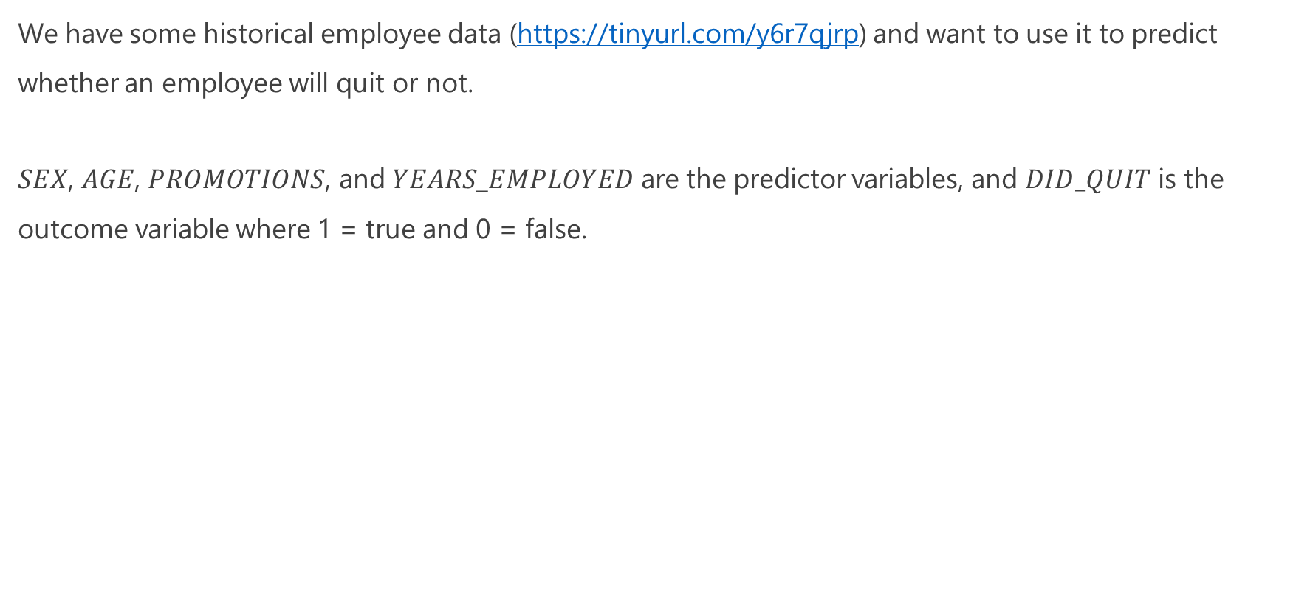
Multivariable Logistic Regression
We have some historical employee data (https://tinyurl.com/y6r7qjrp) and want to use it to predict whether an employee will quit or not.
$SEX$, $AGE$, $PROMOTIONS$, and $YEARS$_$EMPLOYED$ are the predictor variables, and $DID_QUIT$ is the outcome variable where 1 = true and 0 = false.

Slide 27
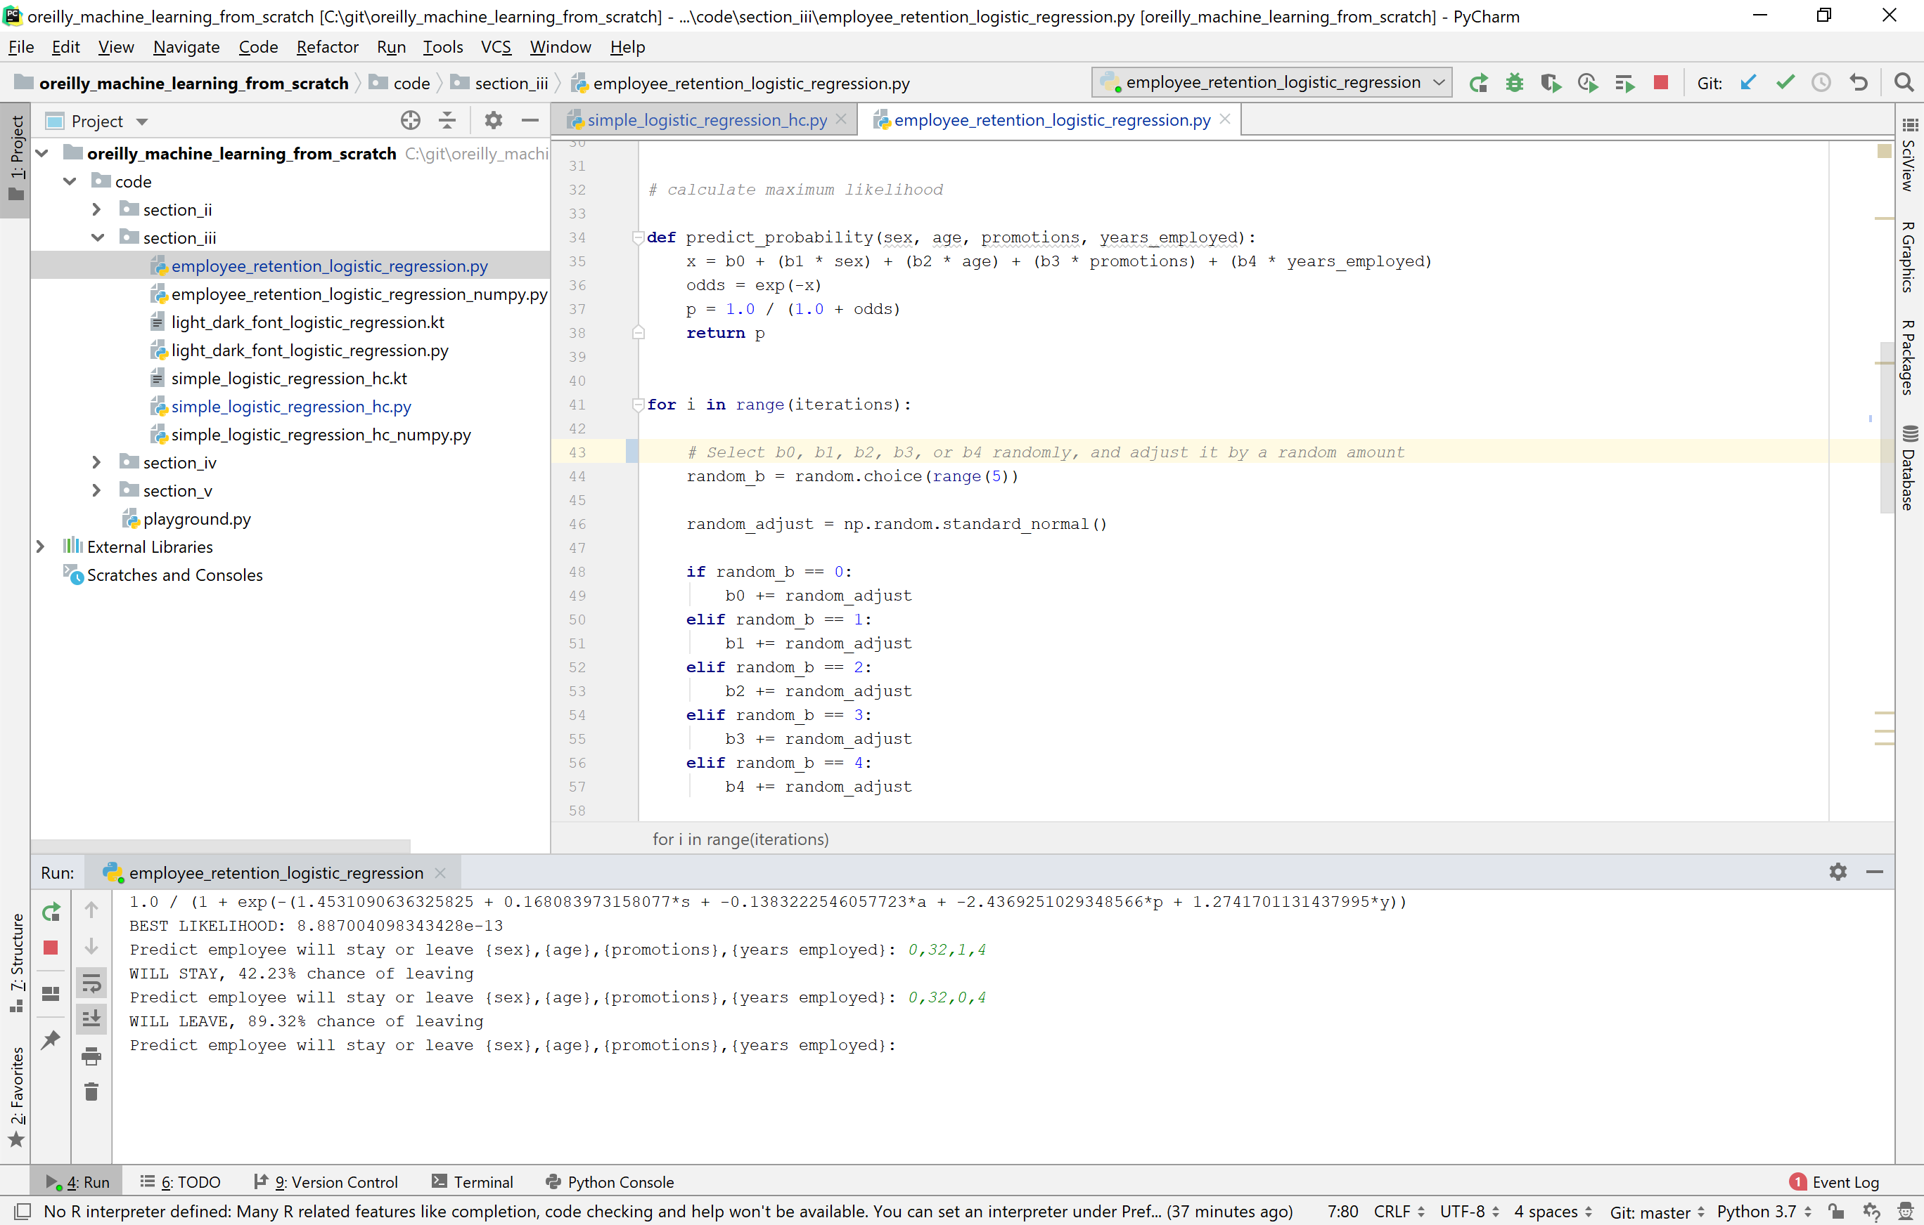
Hands-On: Multivariable Logistic Regression

Slide 28
Using Logistic Regression for Classification
Logistic regression may seem limited in that it only supports two categories: true (1) or false (0).
But you can make it support any number of categories!
To use logistic regression for more than two categories:
Build a separate logistic regression for each category, where a given item belongs to that category (1) or doesn’t belong to that category (0).
To predict which category an item belongs to, pass it through each category’s logistic regression, and choose the one with the highest probability.

Slide 29
Quiz Time!
Logistic regression will only output a probability between 0 and 1 that an event will happen.
True
False

Slide 30
Quiz Time!
Logistic regression will only output a probability between 0 and 1 that an event will happen.
True
False
Like any probability model, logistic regression will output a percentage between 0 and 1

Slide 31
Quiz Time!
Logistic regression cannot be used for more than two categories.
True
False

Slide 32
Quiz Time!
Logistic regression cannot be used for more than two categories.
True
False
Logistic regression can support more than one category by doing a separate logistic regression for each category, and predicting the one that yields the highest probability.

Slide 33
Section II Space Shuttle Challenger

Slide 34
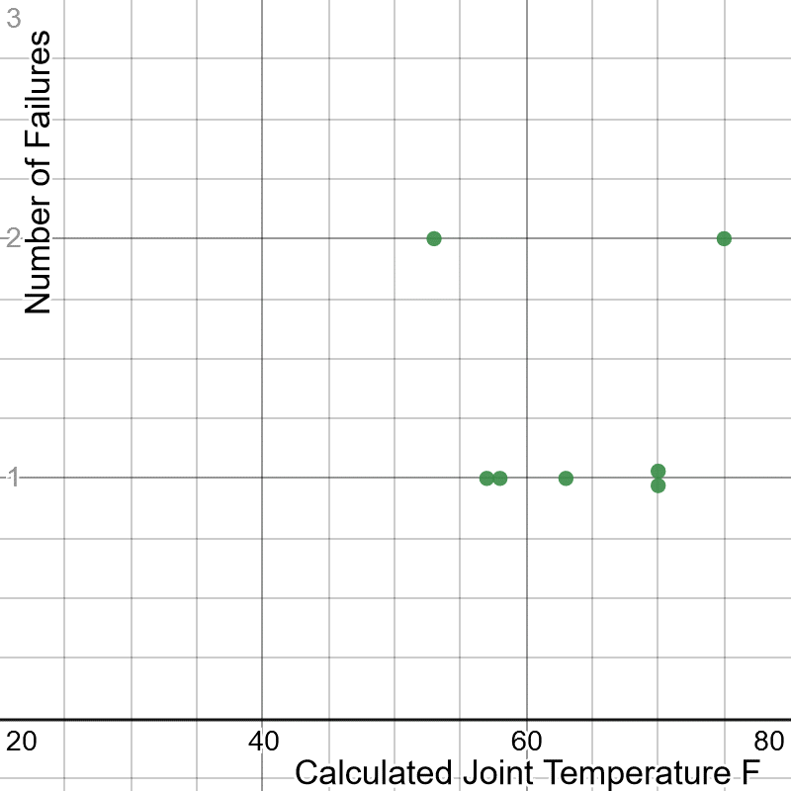
Exercise: “There’s No Correlation”
It is one day from a manned space launch.
However, your engineering team has been expressing concern about the O-Rings that seal rocket gases from releasing, and whether they perform in colder temperatures.
You share this concern with other parties and are provided data of all 7 O-Ring failures from 24 launches and the temperature (shown to the right).
The consensus from other parties is there is no correlation between number of failures and temperature.
Is this assessment correct?
Data Source: http://www.math.usu.edu/~symanzik/teaching/2009_stat6560/RDataAndScripts/sharif_abbass_project1_challenger.csv

Slide 35
Exercise: “There’s No Correlation”
It is one day from a manned space launch.
However, your engineering team has been expressing concern about the O-Rings that seal rocket gases from releasing, and whether they perform in colder temperatures.
You share this concern with other parties and are provided data of all 7 O-Ring failures from 24 launches and the temperature (shown to the right).
The consensus from other parties is there is no correlation between number of failures and temperature.
Is this assessment correct? Is anything missing?
Data Source: http://www.math.usu.edu/~symanzik/teaching/2009_stat6560/RDataAndScripts/sharif_abbass_project1_challenger.csv

Slide 36
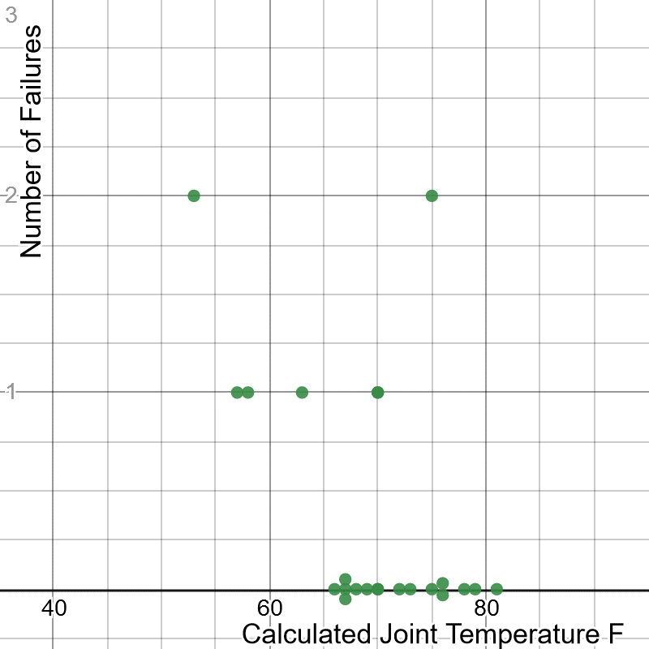
Exercise: “There’s No Correlation”
Notice that data from successful launches were not included, which may tell an entirely different story.
What are your thoughts now? Is there a correlation? Is there a model that can be used to predict risk?

Slide 37
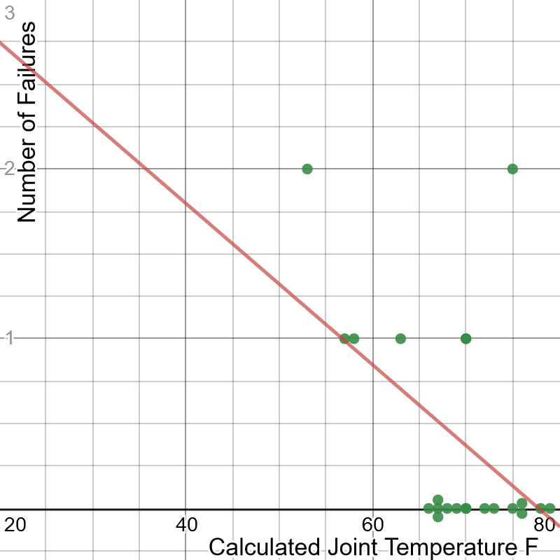
Exercise: “There’s No Correlation”
You can try to apply a linear regression here, and while it does show a trend it is a little awkward especially since our data is sparse.
Should we transform our data somehow? Are there any other models we can try?

Slide 38
Linear Regression Source Code
import pandas as pd from sklearn.linear_model import LinearRegression # Learn more: https://scikit-learn.org/stable/modules/generated/sklearn.linear_model.LinearRegression.html # Import points df = pd.read_csv('https://bit.ly/2DgjTk5', delimiter=",") # Extract input variables (all rows, all columns but last column) X = df.values[:, :-1] # Extract output column (all rows, last column) Y = df.values[:, -1] # Plain ordinary least squares fit = LinearRegression().fit(X, Y) # Print "m" and "b" coefficients print("m = {0}".format(fit.coef_.flatten())) print("b = {0}".format(fit.intercept_.flatten()))

Slide 39
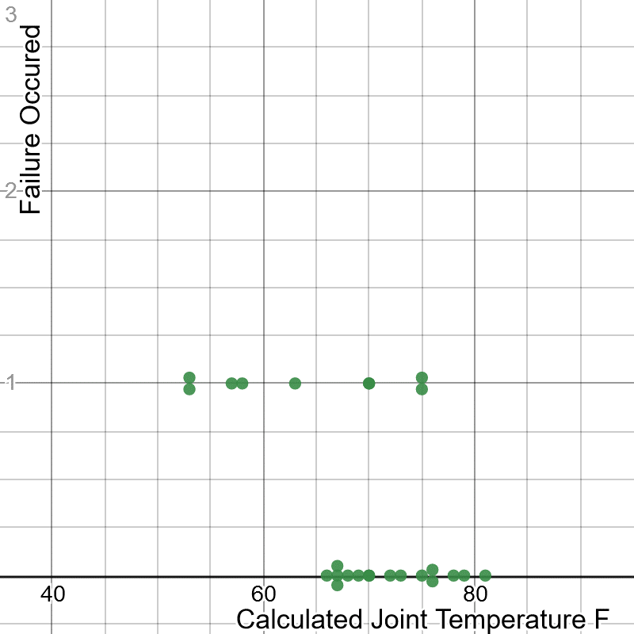
Exercise: “There’s No Correlation”
What if we converted the data to be binary, showing whether a failure occurred or not occurred, by separating each instance into its own record?
This reduces the domain of output variables to “0” and “1” creating a binary model.
Is a story now becoming clear? What model can we use to predict probability of failure at a given temperature?

Slide 40
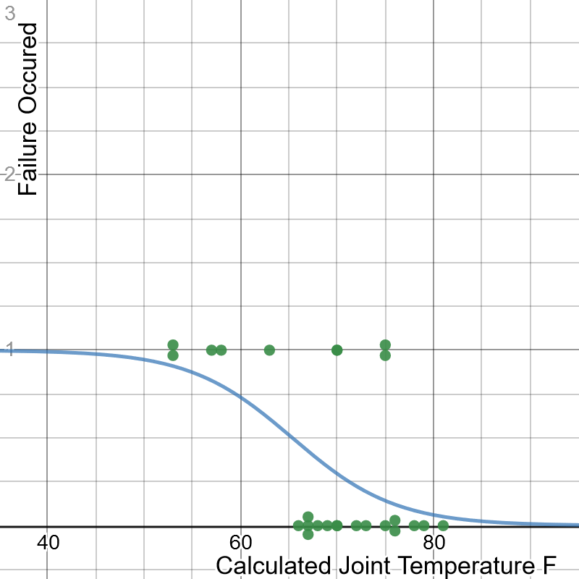
Exercise: “There’s No Correlation”
Logistic regression might be the best way to model this risk.
Even though we lack freezing temperature data, the logistic regression points to a high probability of risk for O-ring failure.
If our launch is going to happen in freezing temperatures, this does not bode well.

Slide 41

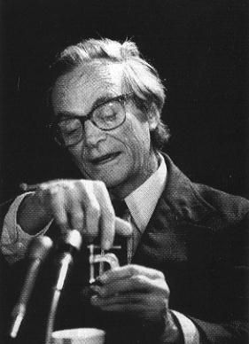
Exercise: “There’s No Correlation”
This is exactly what happened to the space shuttle Challenger on January 28, 1986, and if you already have not figured out already, we are doing the analysis.
Through a series of unfortunate events, only partial data was accessible and omitted non-failure data, which showed a correlation with temperature and O-ring failure.
The analysis we just did should have happened before the accident, but unfortunately it occurred afterwards.
We will learn later about how biases, class imbalance, and broken data can derail machine learning and statistical models.
The space shuttle Challenger just moments before disaster on January 28, 1986 (above) and Richard Feynman famously demonstrating O-ring failure with a glass of ice water (left).

Slide 42
Space Shuttle Challenger: Logistic Regression Source Code
import numpy as np import pandas as pd import plotly.graph_objects as go from sklearn.linear_model import LogisticRegression # Load the data df = pd.read_csv("https://bit.ly/2DgjTk5", delimiter=",") # Duplicate and convert records to have binary outcomes df = df.loc[df.index.repeat(df["o_ring_failures"])].append(df[df["o_ring_failures"] == 0]) df.loc[(df["o_ring_failures"] > 0), 'o_ring_failures'] = 1 # Extract input variables (all rows, all columns but last column) X = df.values[:, :-1] # Extract output column (all rows, last column)\ Y = df.values[:, -1] model = LogisticRegression() model.fit(X, Y) # Print "m" and "b" coefficients print("m = {0}".format(model.coef_.flatten())) print("b = {0}".format(model.intercept_.flatten())) # Plot results fig = go.Figure() fig.add_trace(go.Scatter(x=df["temperature"], y = df["o_ring_failures"], mode='markers', name="Observations")) fig.add_trace(go.Scatter(x=np.arange(0.0,90.0,.1), y= model.predict_proba(np.arange(0.0,90.0,.1).reshape(-1, 1))[:,-1], mode='lines', name='Logistic Regression')) fig.show()

Slide 43
Section III Preparing and Rescaling Data

Slide 44

Normalization
Normalization is scaling and converting the values of each variable, so they are relatively close together.
Imagine you had a variable age whose values typically range in 0-99.
But you had another variable income that typically ranges from 30,000 to 1,000,000.
Because these ranges are so drastically different, fitting a model is not going to be productive until you transform them somehow.
There are a variety of techniques you can employ from linear scaling to fitting to a standard normal distribution.

Slide 45
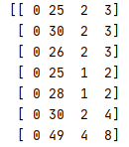
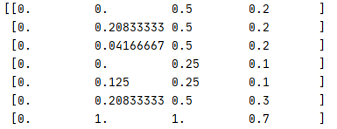
Rescaling
When you have different fields with varying scales, it can be helpful to rescale, or normalize, the data by compressing it between 0.0 and 1.0.
This can be helpful for optimization algorithms that perform training, making it easier to iterate parameters to fit the data more productively.
Note you do not always have to rescale, but sometimes it can give a better result especially for data with fields that vary in scale.
import pandas as pd from sklearn.preprocessing import MinMaxScaler df = pd.read_csv('https://bit.ly/33iTfS9', delimiter=",") # Extract input variables (all rows, all columns but last column) X = df.values[:, :-1] # Extract output column (all rows, 5th column) Y = df.values[:, 4] # Rescale all the input variables to be between 0 and 1 scaler = MinMaxScaler(feature_range=(0.0, 1.0)) rescaled_X = scaler.fit_transform(X) print(rescaled_X)
Doing a simple rescale between 0.0 and 1.0 above in scikit-learn

Slide 46
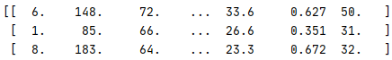
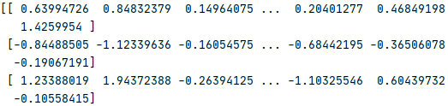
Standardization
Standardization is transforming numeric variables to fit a standard normal distribution (with a mean of 0 and standard deviation of 1) and express each value in standard deviations.
It can be preferable to rescaling, if the data can assume a normal distribution for each variable.
In other words, standardization is finding the z-scores for each variable.
import pandas as pd from sklearn.preprocessing import StandardScaler df = pd.read_csv('https://bit.ly/3flZJSR', delimiter=",") # Extract input variables (all rows, all columns but last column) X = df.values[:, :-1] # Extract output column (all rows, last column) Y = df.values[:, -1] # Rescale all the input variables to be between 0 and 1 scaler = StandardScaler().fit(X) rescaled_X = scaler.fit_transform(X) print(rescaled_X)
Doing a standardization on all data fields

Slide 47
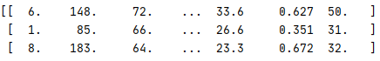
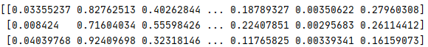
Unit Vector Normalization
Not to be confused with standardization, unit vector normalization is rescaling each data record to have a vector length of 1.0.
This is probably the most complicated transformation, as it involves some understanding of linear algebra.
It works well for sparse data sets and it compresses the data into a smaller space, which is especially helpful for high-dimension datasets.
It is often used for neural networks, k-nearest neighbors, and a few other ML algorithms.
import pandas as pd from sklearn.preprocessing import Normalizer df = pd.read_csv('https://bit.ly/3flZJSR', delimiter=",") # Extract input variables (all rows, all columns but last column) X = df.values[:, :-1] # Extract output column (all rows, last column) Y = df.values[:, -1] # Rescale all the input variables to be normalized scaler = Normalizer().fit(X) rescaled_X = scaler.fit_transform(X) print(rescaled_X)
Doing a normalization on all data fields

Slide 48
Section IV Classification Validation

Slide 49
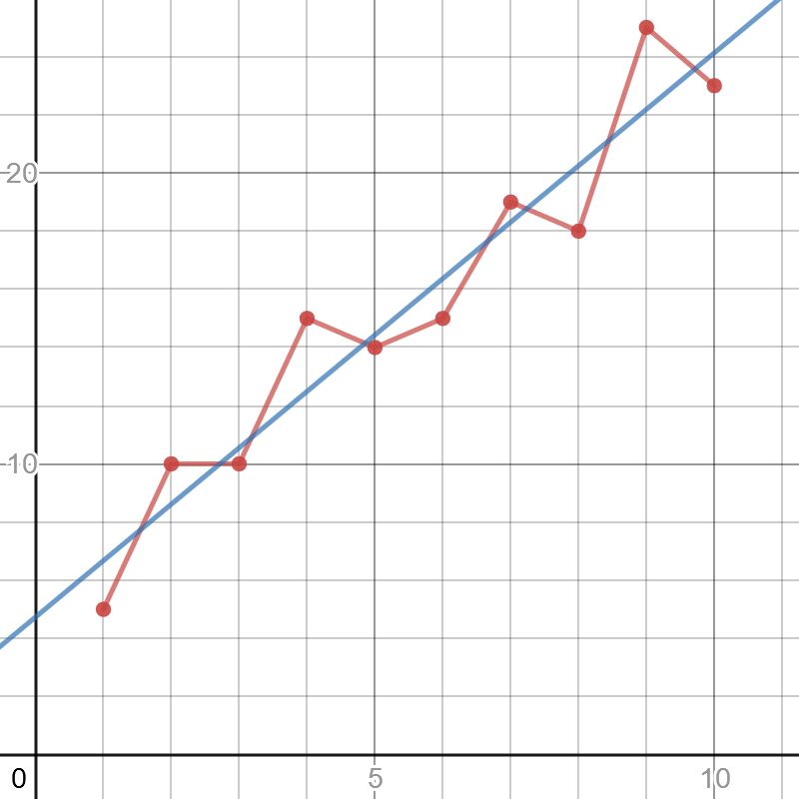
A Note About Overfitting
We are not going to focus too much on validating and analyzing machine learning models, but we should at least mention overfitting.
Overfitting means that our ML model works well with the data it was trained on but fails to predict correctly with new data.
This can be due to many factors, but a common cause is the sampled data does not represent the larger population and more data is needed.
The red line has high variance, meaning its predictions are sensitive to outliers and therefore can vary greatly.
The blue line has high bias, meaning the model is less sensitive to outliers because it prioritizes a method (maintaining a straight line) rather than bend and respond to variance.
The red line to the right is likely overfitted (high variance, low bias), but the blue linear regression line (low variance, high bias) is less likely to be overfit.
https://www.desmos.com/calculator/wmwfolbvdk

Slide 50
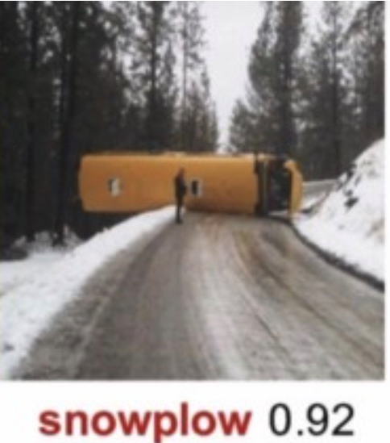

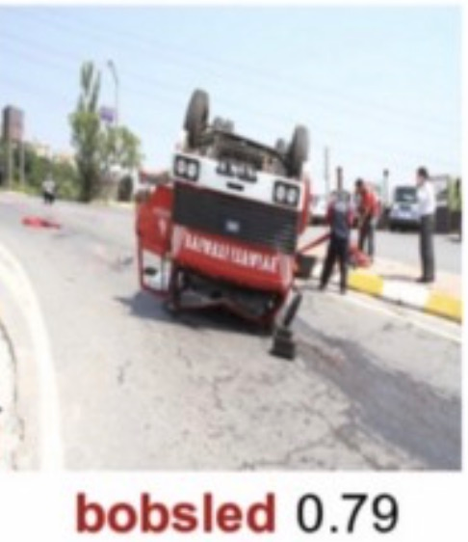
ML Classification is Not Perfect
Machine learning algorithms are not perfect and easily error-prone especially with outliers.
Generally, the more “advanced” and flexible a machine learning method is the more prone it is to overfitting.
To the right are examples of a well-trained neural network unable to recognize images correctly due to objects in abnormal positions
SOURCE: https://arxiv.org/abs/1811.11553

Slide 51

A Note About Overfitting
Linear and logistic regression are highly biased methods and are resilient to overfitting.
There are other remedies to mitigate overfitting, the most basic being separating training data and test data.
The model is fit to the training data, and then is tested with the test data.
If the test data performs poorly compared to the training data, there is a possibility of overfit (or just no correlation altogether).
You can also try to train with more data as well as utilize cross-validation, regularization, bagging, boosting, and other techniques.

Slide 52
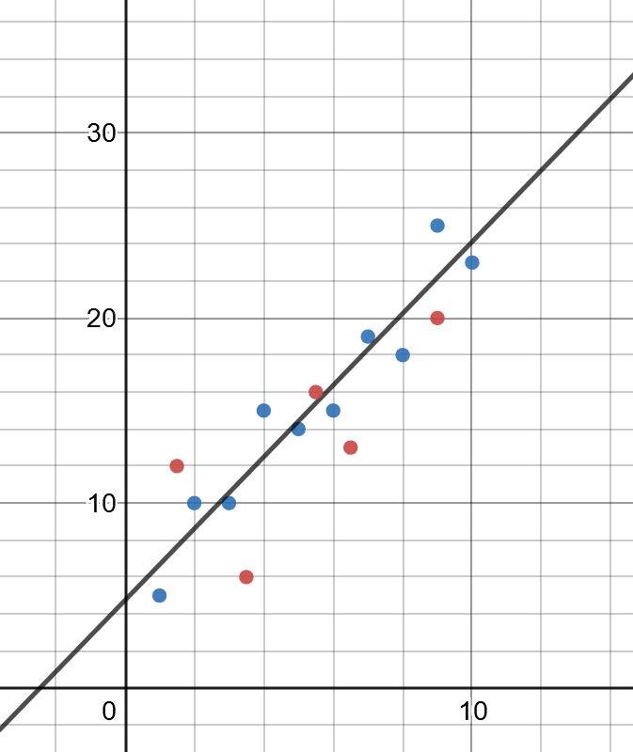
Training and Testing Data
A common practice to proactively prevent overfitting in machine learning is to separate training data and testing data.
Training data is data used to fit a model and is typically 2/3 of the data.
Test data is used to test the model and is the remaining 1/3 of the data.
By omitting the testing data from training, we see how well the model works on data it has not seen before and change our parameters accordingly.
DATA
TRAINING
TESTING

Slide 53
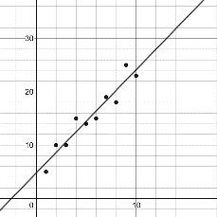
Cross-Validation
We can take this concept of training/testing data a step further, and test different combinations of training and testing data.
This is known as cross-validation, the gold standard of validation techniques.
To the right we have 3-fold cross validation which breaks the data into thirds and uses one of the pieces for testing.
We can then evaluate how well each of these perform, being able to compare different parameters and models (e.g. linear regression vs decision trees) and see which setup produces the best performance.
DATA
TRAINING
TRAINING
TESTING
TRAINING
TESTING
TRAINING
TESTING
TRAINING
TRAINING

Slide 54
Cross-Validation
We can take this concept of training/testing data a step further, and test different combinations of training and testing data.
This is known as cross-validation, the gold standard of validation techniques.
To the right we have 3-fold cross validation which breaks the data into thirds and uses one of the pieces for testing.
We can then evaluate how well each of these perform, being able to compare different parameters and models (e.g. linear regression vs decision trees) and see which setup produces the best performance.
DATA
TRAINING
TRAINING
TESTING
TRAINING
TESTING
TRAINING
TESTING
TRAINING
TRAINING

Slide 55
Cross-Validation
TRAINING
Note that k-fold cross validation allows us to slice our data into any number and not just 3 (typically 3, 5, or 10).
For example we can do 10-fold cross validation and validate 10 different combinations of training/test data.
The most extreme form of folding is leave-one-out cross validation, which omits one data record for testing and uses the remaining records for training, and this is done repeatedly.
TRAINING
TRAINING
TRAINING
TRAINING
TRAINING
TRAINING
TRAINING
TRAINING
TESTING

Slide 56
Random Fold Validation
As you may be noticing, machine learning often tries to overcome data variance with randomness.
A variant with fold validation is repeated random fold validation, where we randomly shuffle the data and create random train/test folds as many times as desired.
This is helpful when we need to mitigate variance in the model.
DATA

Slide 57
Which Validation to Use?
TRAINING
Generally, you will want to prefer k-fold validation as it is the gold standard.
A single train/test split might be warranted if performance of machine learning algorithm is slow and has enough data with lower bias.
Use the random fold split to mitigate variance in the model while balancing training speed and dataset sizes.
We will talk about class imbalance later, but if you do not have an equal number of samples for each class, you might want to consider using stratification in your k-fold validation.
Stratification means an equal proportion of data for each class is sampled for training and testing data (even it is sampled repeatedly), so that no class is neglected.
TESTING
TRAINING
TRAINING
TESTING
TRAINING
TESTING
TRAINING
TESTING
TRAINING
TRAINING

Slide 58
A Stratified Validation in Scikit-Learn
import numpy as np import pandas as pd # load data from sklearn.model_selection import train_test_split from sklearn.neural_network import MLPClassifier df = pd.read_csv(“https://tinyurl.com/y6r7qjrp”, delimiter=",") # Extract input variables (all rows, all columns but last column) # Note we should do some linear scaling here X = (df.values[:, :-1] / 255.0) + .01 # Extract output column (all rows, last column) Y = df.values[:, -1] # Get a count of each group to ensure samples are equitably balanced print(df.groupby(["class"]).agg({"class" : [np.size]})) # Separate training and testing data # Note that I use the 'stratify' parameter to ensure # each class is proportionally represented in both sets X_train, X_test, Y_train, Y_test = train_test_split(X, Y, test_size=.33, stratify=Y) nn = MLPClassifier(solver='sgd', hidden_layer_sizes=(100, ), max_iter=480, learning_rate_init=.1) nn.fit(X_train, Y_train) print("Training set score: %f" % nn.score(X_train, Y_train)) print("Test set score: %f" % nn.score(X_test, Y_test))

Slide 59
Validation Data
Validation is a separate type of testing data used to compare performance of different models.
When you are comparing two or more models (e.g. logistic regression versus decision trees), you may hold back one more chunk of data for validation.
It is different than the testing data, which is used to tune parameters of the individual model, not compare different models altogether.
DATA
TRAINING
TESTING
VALIDATION

Slide 60

Random Seeding
Machine learning deals with a lot of random-based operations:
Randomly sampled training/testing data
Random-based optimization and training (e.g. stochastic gradient descent, simulated annealing)
Randomly generated data from simulations
Testing can be challenging as the above operations make outputs nondeterministic, so setting a random seed is common practice to make them deterministic.
This allows tests to be conveniently reproducible, where sequences of randomly generated values are the same.
Be careful to not rely on random seeds too much! They can give the illusion of determinism so test many random seeds, not just one, to ensure they converge towards the same outcome.

Slide 61
Random Seeding a 3-Fold Split for Reproducibility
import pandas as pd from sklearn.linear_model import LogisticRegression from sklearn.model_selection import KFold, cross_val_score # Load the data df = pd.read_csv(“https://tinyurl.com/y6r7qjrp”, delimiter=",") X = df.values[:, :-1] Y = df.values[:, -1] # "random_state" is the random seed, which we fix to 7 kfold = KFold(n_splits=3, random_state=7, shuffle=True) model = LogisticRegression(solver='liblinear') results = cross_val_score(model, X, Y, cv=kfold) print("Accuracy Mean: %.3f (stdev=%.3f)" % (results.mean(), results.std()))

Slide 62
Katacoda – Task 2
https://learning.oreilly.com/scenarios/data-science-math/9781098108601/

Slide 63


Why “Accuracy” is a Bad Measure for Classification
Suppose your machine learning model observed people with the name “Michael” quit their job.
Therefore it simply predicts any employee with the name “Michael” will quit, and everyone else will stay.
If there was one Michael in a company of 100 employees, but a different employee ended up quitting, the machine could still boast 98% accuracy.
Why stop there? If 99% of employees do not quit, you might as well predict every employee will not quit and get 99% accuracy.
Machine learning makes shortcuts like this all the time especially when the event of interest is rare (e.g. diseases, security breaches, employee attrition, rare road/highway events).
This employee quits
Prediction was wrong
But I’m still 98%
accurate!
Prediction
This employee is named “Michael”
This employee will quit

Slide 64
Confusion Matrix
As seen in the previous example, accuracy (the rate of correct labeling) can be a misleading measure of performance, especially in classification problems with class imbalance.
A better way to evaluate classification models is the confusion matrix, which keeps track of false positives (Type I Error) and false negatives (Type II Error).
We want to evaluate how many employees who were predicted to quit actually did quit (true positives).
Conversely, we also want to evaluate how many employees who were predicted to stay actually did stay (true negatives).
 | Actually Quits (True) | Actually Stays (False)
Predicted will quit (True) | 0 | 1
Predicted will stay (False) | 1 | 98

Slide 65
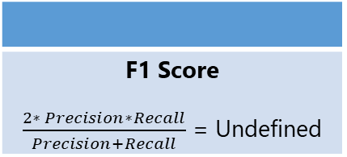
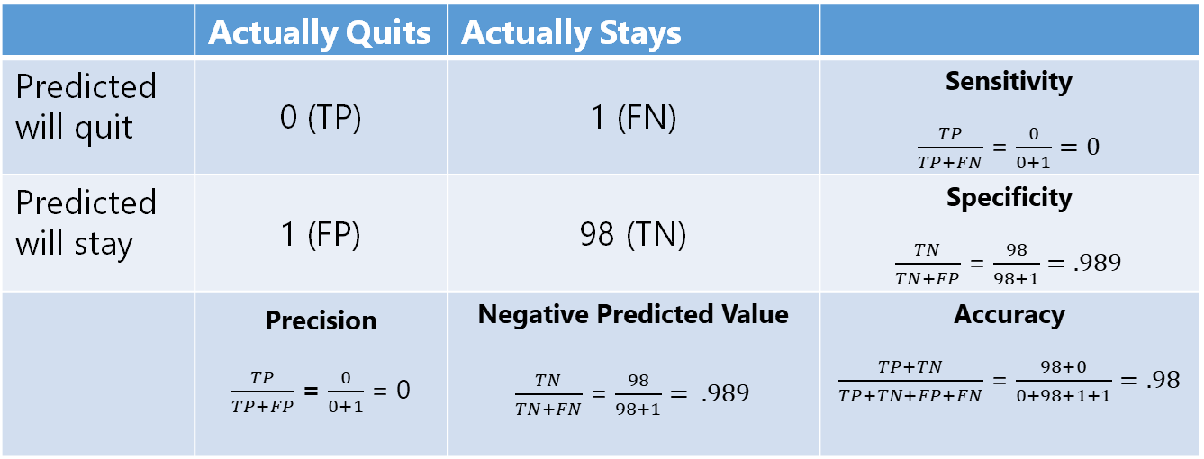
Confusion Matrix
From the confusion matrix, we can derive all sorts of useful metrics beyond just accuracy.
We can easily see that precision (how accurate positive predictions were) and sensitivity (rate of identified positives) are 0, meaning this machine learning model fails entirely at positive predictions.
 | Actually Quits | Actually Stays
Predicted will quit | 0 (TP) | 1 (FN) | Sensitivity $\frac{TP}{TP+FN}$ = $\frac{0}{0+1}=0$
Predicted will stay | 1 (FP) | 98 (TN) | Specificity $\frac{TN}{TN+FP}$ = $\frac{98}{98+1}=.989$
 | Precision $\frac{TP}{TP+FP}$ = $\frac{0}{0+1}$ = 0 | Negative Predicted Value $\frac{TN}{TN+FN}$ = $\frac{98}{98+1}= .989$ | Accuracy $\frac{TP+TN}{TP+TN+FP+FN}$ = $\frac{98+0}{0+98+1+1}=.98$
F1 Score $\frac{2∗ Precision∗Recall}{Precision+Recall}$ = Undefined

Slide 66
ROC and AUC
When we are evaluating different machine learning configurations, we may end up with dozens, hundreds, or thousands of confusion matrices.
These can be tedious to review, so we can summarize all of them with a receiver operator characteristic (ROC) curve as shown to the right.
This allows us to see each testing instance (each represented by a black dot) and find an agreeable balance between true positives and false positives.
True Positive Rate (Sensitivity)
False Positive Rate (1 - Specificity)

Slide 67
ROC and AUC
We can also compare different machine learning models by creating separate ROC curves for each.
For example, if our red curve represents a logistic regression and the blue curve represents a decision tree, we can see the performance of them side-by-side.
The area under the curve (AUC) is a good metric for choosing which model to use. Since the red curve (logistic regression) has a greater area, this suggests it is a superior model.
True Positive Rate (Sensitivity)
False Positive Rate (1 - Specificity)

Slide 68

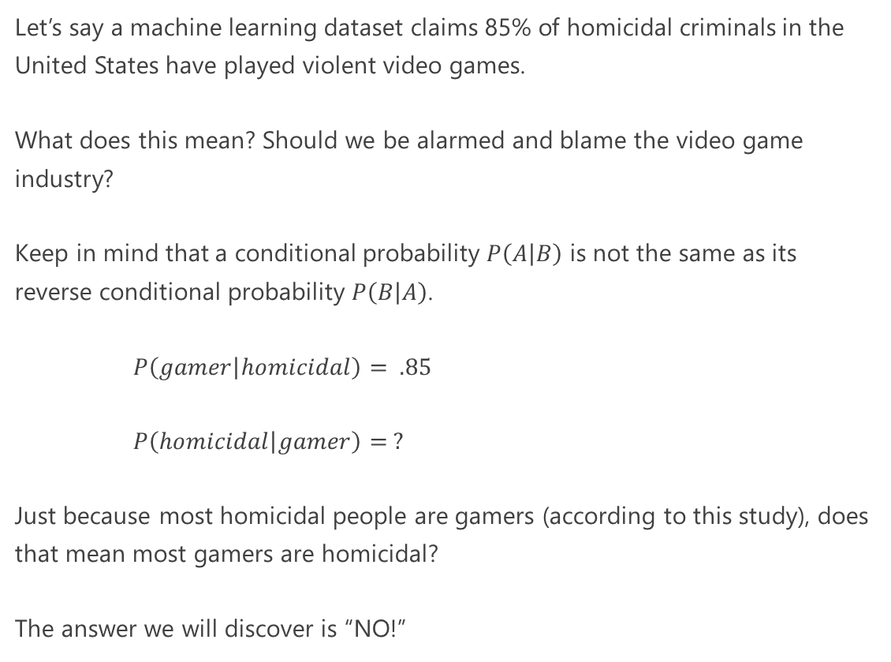
Violence and Video Games
Let’s say a machine learning dataset claims 85% of homicidal criminals in the United States have played violent video games.
What does this mean? Should we be alarmed and blame the video game industry?
Keep in mind that a conditional probability $P\left(\left.A\right|B\right)$ is not the same as its reverse conditional probability $P\left(\left.B\right|A\right)$.
$P\left(\left.gamer\right|homicidal\right)= .85$
$P\left(\left.homicidal\right|gamer\right)= ?$
Just because most homicidal people are gamers (according to this study), does that mean most gamers are homicidal?
The answer we will discover is “NO!”
This Photo is licensed under CC BY

Slide 69
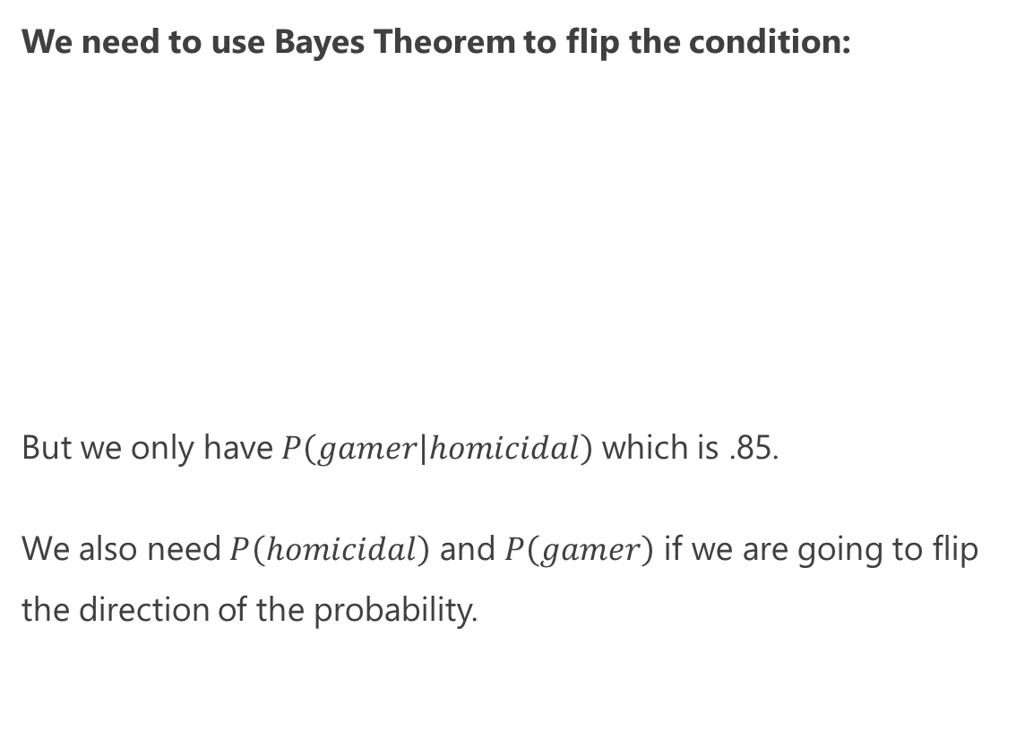
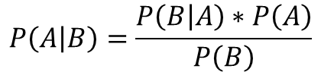
Violence and Video Games
We need to use Bayes Theorem to flip the condition:
But we only have $P\left(\left.gamer\right|homicidal\right)$ which is .85.
We also need $P\left(homicidal\right)$ and $P\left(gamer\right)$ if we are going to flip the direction of the probability.
$$P\left(\left.A\right|B\right)=\frac{P\left(\left.B\right|A\right)∗P\left(A\right)}{P\left(B\right)}$$
$$P\left(\left.homicidial\right|gamer\right)=\frac{P\left(\left.gamer\right|homicidal\right)∗P\left(homicidal\right)}{P\left(gamer\right)}$$
This Photo is licensed under CC BY

Slide 70
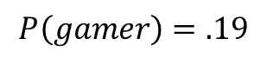
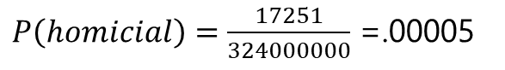
Violence and Video Games
Sometimes it can be hard to get these other probabilities, but with population studies a little bit of research might give us some numbers.
According to the FBI, there are 17,251 known homicidal offenders in 2017 and according to Wolfram Alpha there are 324 million people in the United States.
Gathering data from video game industry market research, you estimate that 19% of the population plays violent video games.
This Photo is licensed under CC BY
$P\left(homicial\right)=\frac{17251}{324000000}$ =.00005
$$P\left(gamer\right)=.19$$

Slide 71
Discovering Bayes Theorem
Unlike the media and politicians, we continued doing the math and research and found 19% of the population plays violent video games, and .005% of the population is homicidal.
We can use Bayes Theorem to merge these probabilities together.
P(Homicidal if Gamer) = P(Gamer if Homicidal) * P(Homicidal) / P(Gamer)
P(Homicidal if Gamer) = (.85 * .00005) / .19
P(Homicidal if Gamer) = 0.0002
Wow! So if you take any gamer there is only a .02% chance they are homicidal.
This number is much different than the 85% probability a homicidal criminal is a gamer.
This Photo is licensed under CC BY

Slide 72

Bayes and the Confusion Matrix
A medical technology vendor approaches your organization and says they have an “AI system” that takes a small blood sample, assays several variables, ensembles machine learning algorithms, and predicts a health risk (simply categorized as “AT RISK” or “NOT AT RISK”).
The vendor says that 99% of patients who are at risk will test positive.
Is this significant and credible? Why or why not? What should our next questions be?

Slide 73
Bayes and the Confusion Matrix
There is still some missing information you will have to solicit from the vendor.
We are told that for patients that have health risk, 99% will be identified successfully (sensitivity).
But what if we flip the question? What percentage of those who tested positive have the health risk (precision)?
The vendor goes back to their research team and returns with a confusion matrix of 1000 patients they tested.
They give you an answer: 198 / (198 + 50) = 79.8%

Slide 74
Bayes and the Confusion Matrix
With this confusion matrix, we indeed see 99% of those who are at risk test positive, and that 79.8% of those tested positive are at risk. We found the conditional probability in both directions.
Despite these numbers, you start to feel uncomfortable that you are not using outside data beyond the vendor’s test.
What else can we do to verify the vendor’s claims and testing results?

Slide 75
Bayes and the Confusion Matrix
After some Wikipedia research, you discover something pivotal…
Only 1% of the population is at risk.
This means if you planned on deploying this test to 100K patients, only 1000 are likely at risk.
The vendor advertised a 99% true positive rate. You now wonder: will the vendor’s product single out these 1000 patients? Out of 100K? Without error?

Slide 76
Bayes and the Confusion Matrix
If you feel like something is off because only 1% of the population has the health risk, but 20% of the test patients do, you would be right.
Utilizing Bayes Theorem, we can incorporate this 1% statistic to find the true probability of being at risk if tested positive.
P(At Risk if Positive) = P(Positive if at risk) * P(At risk) / P(Positive)
P(At Risk if Positive) = (.99 * .01) / .248
P(At Risk if Positive) = .0339
3.39% is now the probability of risk given a positive test. How did it drop from 99% to 3.39%?

Slide 77
Bayes and the Confusion Matrix
3.39% is now the probability of risk given a positive test. How did it drop from 99% to 3.39%?
This just shows how easily we can get duped by probabilities that are only high in a specific population like the vendor’s 1000 test patients (remember the homicides and video games example)?
So if this test only has a 3.39% probability of successfully identifying a true positive, we probably should not use it.

Slide 78
Imbalanced Data
An open secret with machine learning is that imbalanced datasets are a problem, and practitioners will artificially inflate data to make it balanced.
This means that for predicting a specific event, like criminality, we need to create a balanced dataset where 50% of the data have criminal labels and 50% do not.
As we have seen predicting rare events (criminality, diseases, security breaches, etc) are imbalanced because the event of interest is rare, and techniques like duplicating that data is done to inflate it.

Slide 79
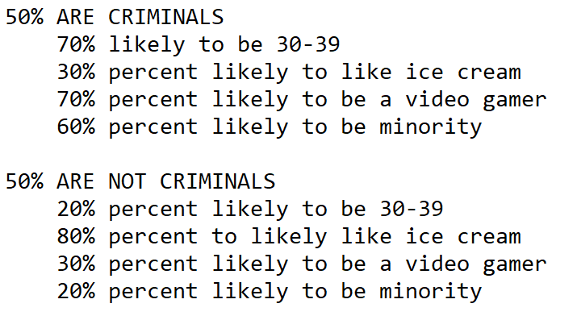
Imbalanced Data
But what is talked less about with imbalanced data is the input variables being imbalanced can cause problems too.
Take this criminal prediction dataset where the input variables have the following proportions:
What do you think is going to happen if I train a machine learning system with this dataset?

Slide 80
Imbalanced Data
Even if I do a 3-fold validation and follow best practices, any machine learning algorithm I throw at it (decision tree, random forest, logistic regression, neural network) is going to discriminate on these imbalances.
Because minorities, video gamers, and certain age groups are overrepresented in a sample as criminals, any machine learning algorithm may single them out as criminals even if this is not representative of the population.
The remedy would be to balance every input variable artificially or through careful and deliberate data sampling that’s representative of the population. ARGH!!!!!!!
This applies also to computer vision and autonomous vehicles, where rare traffic situations (e.g. accident conditions, outrageous events) are going to be highly imbalanced.

Slide 81
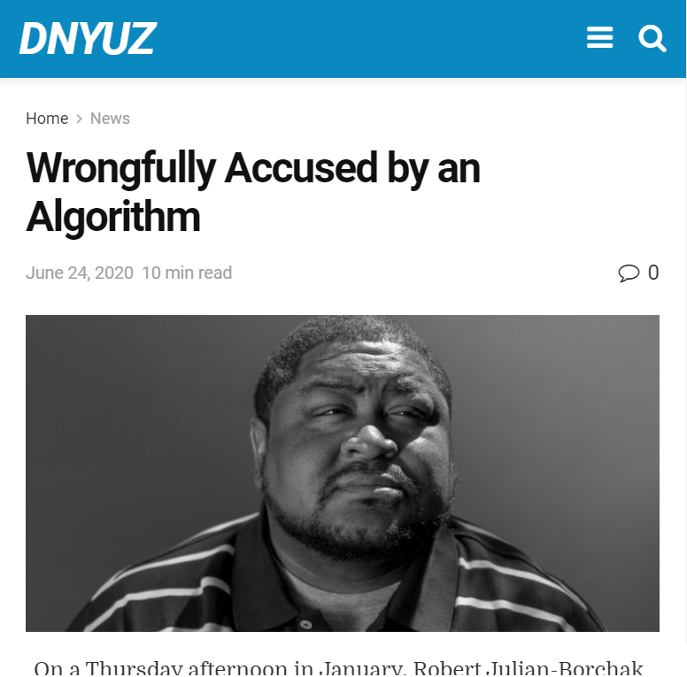
Criminal Justice and Machine Learning
Using machine learning in criminal justice has had challenges.
Minorities are often victim to false positives in facial recognition systems, by a factor of 10 to 100 compared to Caucasian individuals.¹
Paroles and sentencing machine learning systems have had similar problems.²
What makes machine learning precarious for criminal justice is it relies on patterns and thus leverage variables that correlate with race, sex, age, and other discriminatory variables.
Criminal datasets can also be imbalanced, not representing citizens fairly across all demographics.
Confounding variables like income, residence, and commute time can also correlate with prejudicial variables as well.
[1] https://dnyuz.com/2020/06/24/wrongfully-accused-by-an-algorithm/
[2] https://www.technologyreview.com/2019/01/21/137783/algorithms-criminal-justice-ai/

Slide 82
Katacoda – Task 3
https://learning.oreilly.com/scenarios/data-science-math/9781098108601/

Slide 83
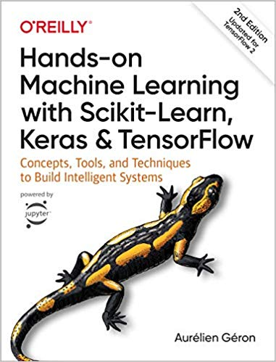
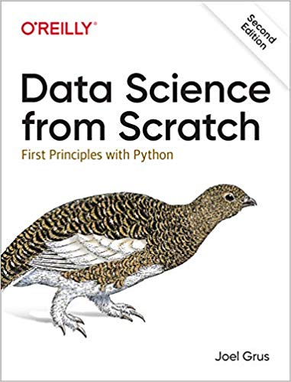
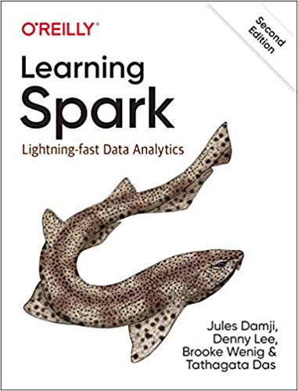
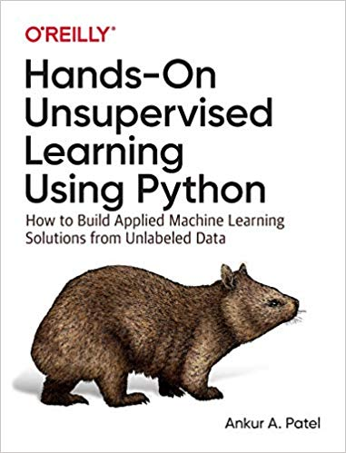
Great Books to Learn More About Machine Learning

